Slide 1


Airline Safety
An Analytic Overview
Presented by: Rachel Nelson
Assignment: 3.3 Project Task 2: Executive Summary

Slide 2
Airline Safety - Overview
Accident and Fatality rates show a decrease trend year over year
Passenger Revenue are showing an upward trend year over year and are forecasted to continue to show a positive increase

Slide 3
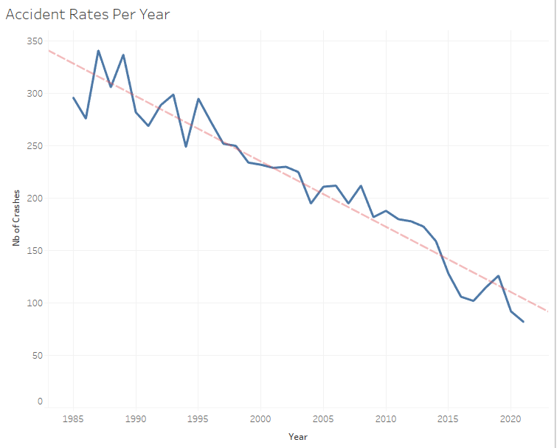
Accident Rates Per Year
Accident Rates have significantly decreased year over year since 1985.

Slide 4
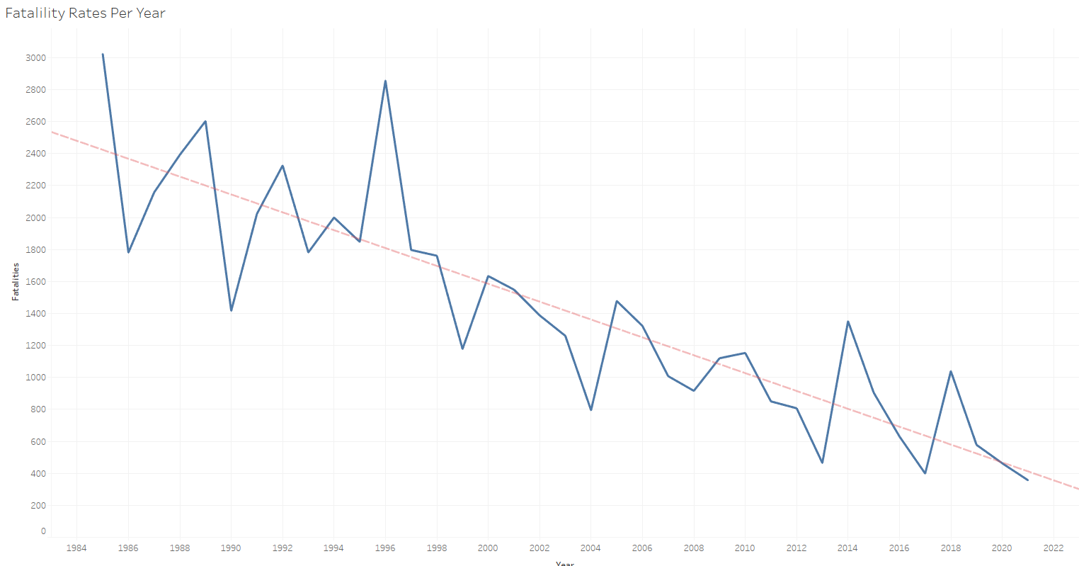
Fatality Rates Per Year
We also see a sharp decline in fatality rates year over year. These indicate that airline safety has increased despite small rises in 2014 and 2018.

Slide 5
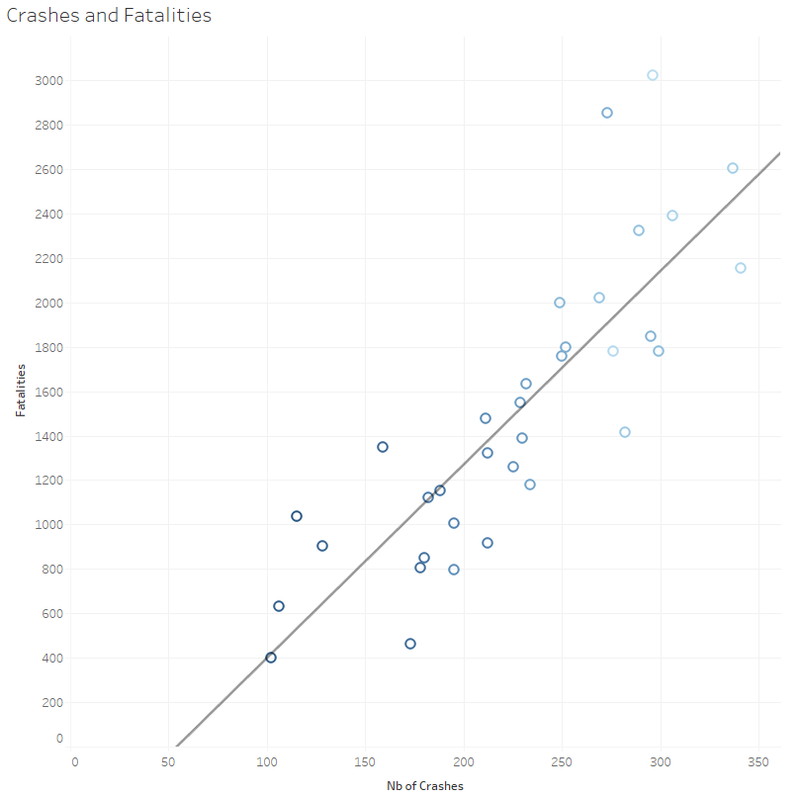
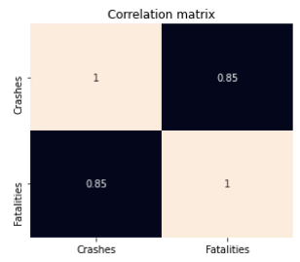
Crashes and Fatality Comparison 1985-2018
7,700 crashes resulting in 51,012 fatalities during the testing period (1985-2018). Crashes are strongly correlated with fatalities.

Slide 6
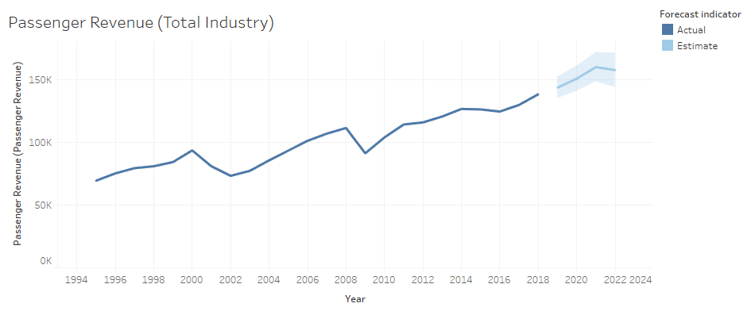
Passenger Revenue (Total Industry)
Using linear regression, we can forecast that passenger revenue will continue to increase for the next three years, showing continued growth in the industry.

Slide 7
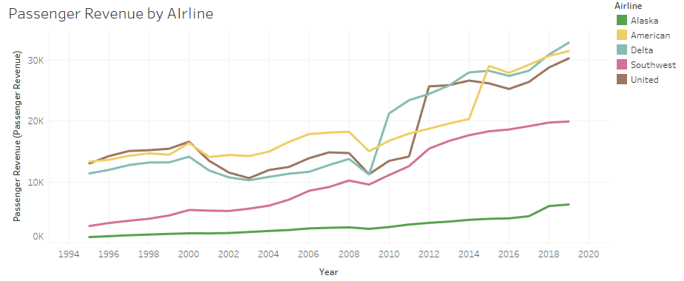
Passenger Revenue by Airline
Alaska, American, Delta, Southwest and United airlines are showing increases in Passenger Revenue.

Slide 8

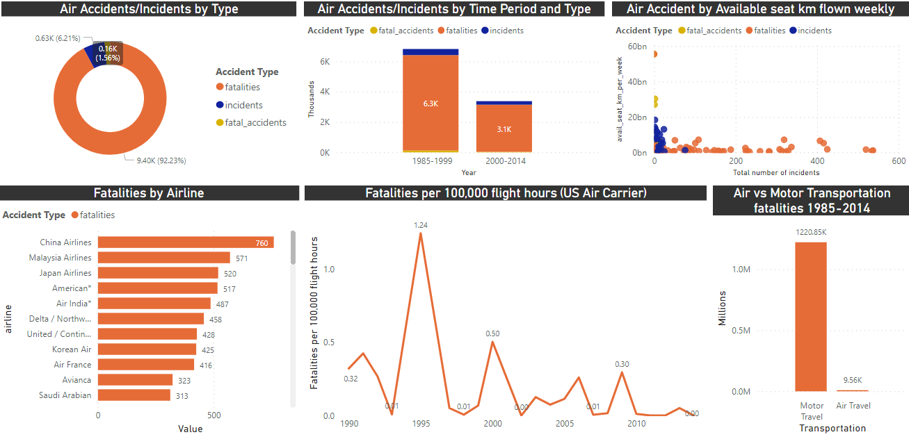
Additional Data and Insights on Airline Safety
There were 9404 total fatalities from 1985-2014
The number of fatalities had a large decrease from 1985-1999 to 2000-2014. This number of total fatalities decreased by half between the two time periods.
The top three airlines with the most fatalities include China, Malaysia and Japan airlines.
The number of airline fatalities is a fraction of Motor fatalities.
Looking at the fatalities trending by year, we can see a decrease of fatalities per 100,000 flight hours
We do not see a spike of fatalities or incidents based on the available seat km per week.

Slide 9
Conclusion
Because airplane accidents are rare, media coverage of such occasions are high. Everyone’s eyes are on the television when these events happen, which may lead to a misperception that airplane travel is less safe. However, data shows that airplane fatalities are less common than motor fatalities

Slide 10
Appendix
Data Source:
airline-safety - Downloaded from: Aviation Safety Network
Supplemental Data Sources:
Motor Crashes - Downloaded from: https://www.iihs.org/topics/fatality-statistics
U.S. Air Carrier Safety Data - Downloaded from: https://www.bts.gov/content/us-air-carrier-safety-dat
Passenger Revenue -- Total System Operations - Downloaded from: MIT
Crashes Per Year/Fatalities Per Year - Downloaded from: Statistics, Bureau of Aircraft Accident Archives
GitHub Repository:
https://github.com/RachelONelson/airline-safety

